Slide 1
AVL Tree Honors Project
James Weber
CSE 310
jaweber7@asu.edu

Slide 2
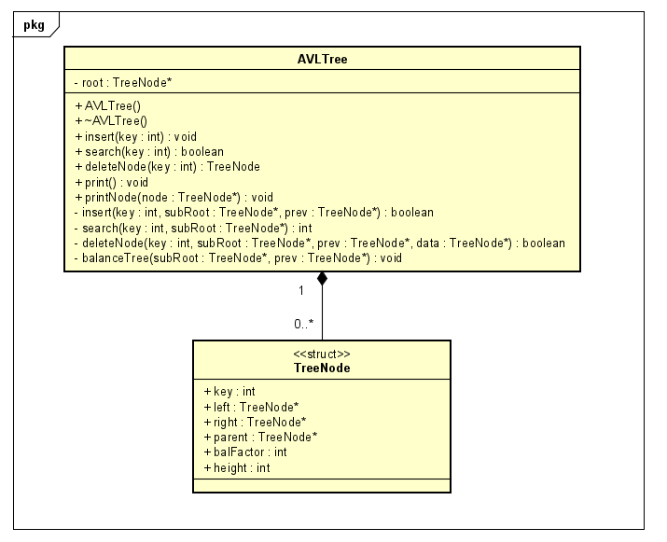
UML Class Diagram

Slide 3
AVL TreeNode
key - data node stores and is sorted by
left, right, parent TreeNode pointers
height - node height from leaf (leaf nodes have height = 1)
balFactor - balance factor. each node in a balanced tree has |balFactor| ≤ 1
h
h
h
key
key
key
bf=-1
bf=0
bf=1
h-1
h-2
h-1
h-1
h-2
h-1
α
β
α
β
α
β

Slide 4
AVL Property
Each TreeNode in a balanced AVL Tree has |balFactor| ≤ 1.
This means each node’s left subtree can differ from its right subtree by at most 1.
This makes an AVLTree’s height O(lgn). (h≈1.44lgn)
2
2
0
1
1
4
0
0
3
5

Slide 5
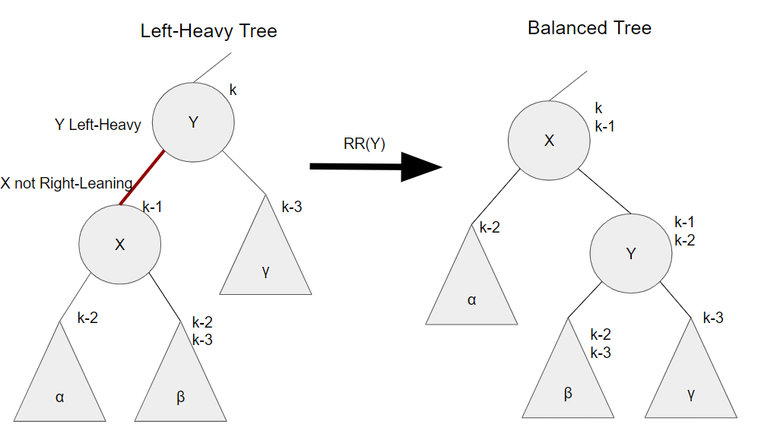
Unbalanced Case #1
Left-Heavy Node with left child that is not Right-Leaning

Slide 6
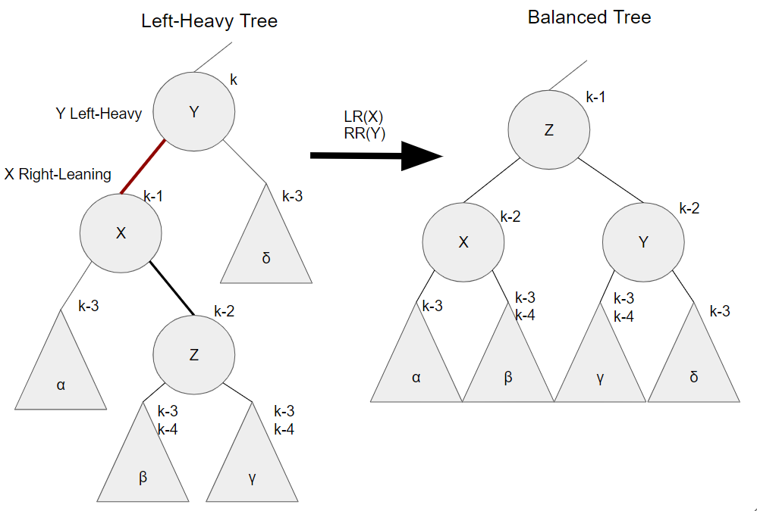
Unbalanced Case #2
Left-Heavy Node with Right-Leaning left child

Slide 7
Insert(500)
500
0

Slide 8
Insert(250)
500
1
0
250

Slide 9
Insert(100)
Unbalanced Tree
500
2
Unbalanced Case #1 (Left)
-1
1
250
100
0

Slide 10
balance(500)
250
1
Right-Rotate(500)
0
0
100
500

Slide 11
Insert(50)
250
2
1
0
100
500
50
0

Slide 12
Insert(75)
Unbalanced Tree
250
3
Unbalanced Case #2 (Left)
2
0
100
500
50
1
75
0

Slide 13
balance(100)
250
2
Left-Right-Rotate(100)
1
0
75
500
50
0
100
0

Slide 14
delete(500)
Unbalanced Tree
250
2
Unbalanced Case #1 (Left)
1
0
75
500
50
0
100
0

Slide 15
balance(250)
75
2
Right-Rotate(250)
1
1
50
250
100
0

Slide 16
delete(50)
Unbalanced Tree
75
2
Unbalanced Case #2 (Right)
1
1
50
250
100
0

Slide 17
balance(75)
Right-Left-Rotate(75)
100
1
0
0
75
250

Slide 18
delete(100)
250
1
0
75

Slide 19
delete(250)
75
0

Slide 20
delete(75)
75
0

Slide 21
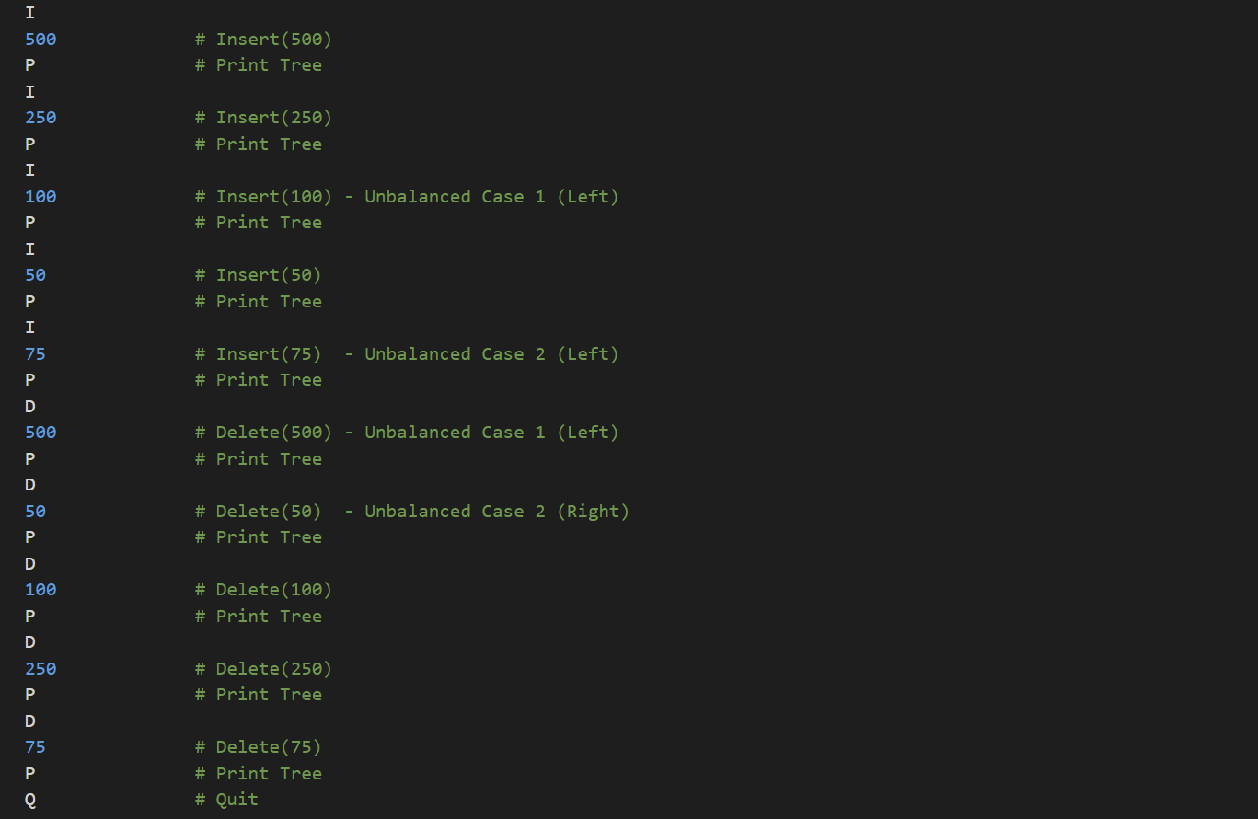
Test Input

